Slide 1
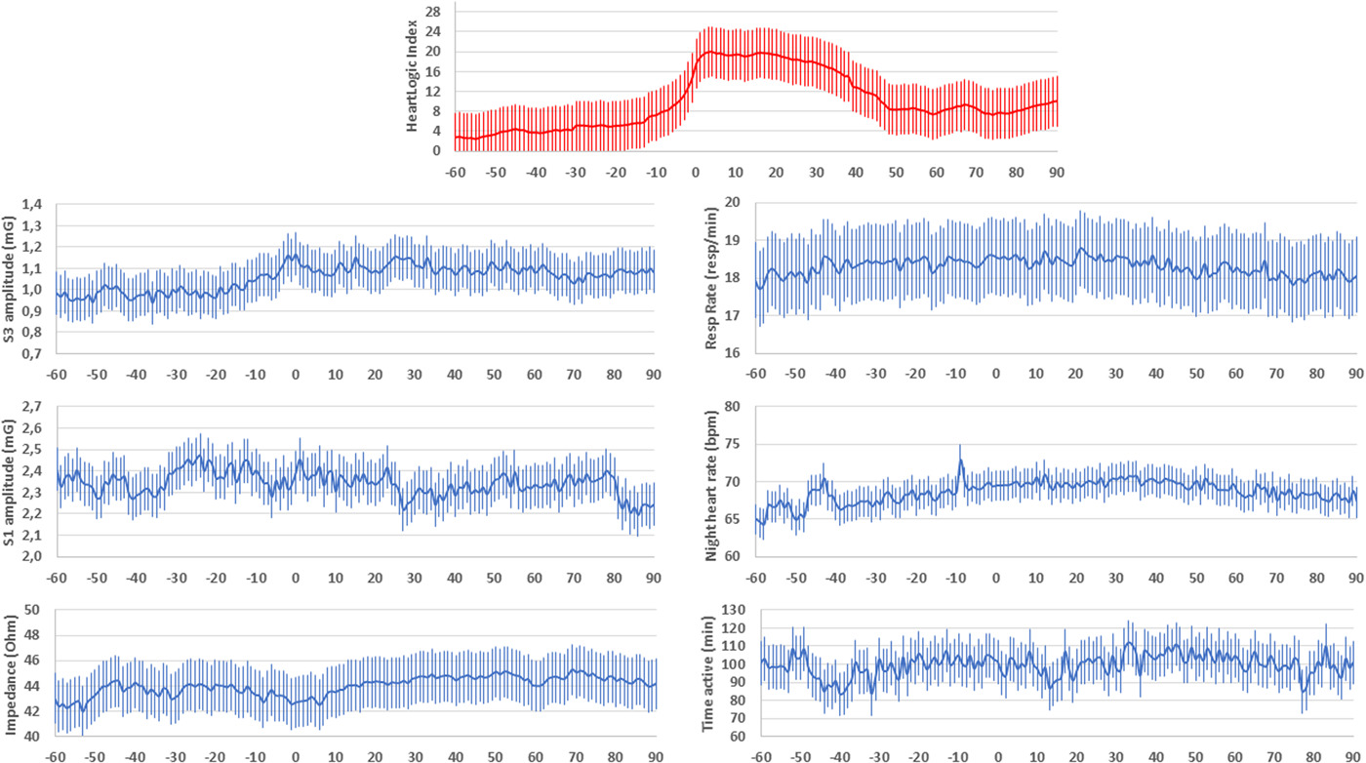
Decongestive treatment adjustments in heart failure patients remotely monitored with a multiparametric implantable defibrillators algorithm
Clinical Cardiology, First published: 03 May 2022, DOI: (10.1002/clc.23832)
Notes:
Average HeartLogic combined index and all physiologic parameters collected by the devices at the time of the alerts that triggered the 56 diuretic therapy adjustments (Day 0 is the day when the HeartLogic index crossed the threshold)
IF THIS IMAGE HAS BEEN PROVIDED BY OR IS OWNED BY A THIRD PARTY, AS INDICATED IN THE CAPTION LINE, THEN FURTHER PERMISSION MAY BE NEEDED BEFORE ANY FURTHER USE. PLEASE CONTACT WILEY'S PERMISSIONS DEPARTMENT ON PERMISSIONS@WILEY.COM OR USE THE RIGHTSLINK SERVICE BY CLICKING ON THE 'REQUEST PERMISSIONS' LINK ACCOMPANYING THIS ARTICLE. WILEY OR AUTHOR OWNED IMAGES MAY BE USED FOR NON-COMMERCIAL PURPOSES, SUBJECT TO PROPER CITATION OF THE ARTICLE, AUTHOR, AND PUBLISHER.

